Slide 1

How can supervised machine learning be used to predict the sales of different vehicle types?
Author Mark Anthony Micallef & Mentor Ivan Briffa
Institute of Information & Communication Technology
MCAST, Paola, Malta

Slide 2
Problem Definition
The demand for motor vehicles has increased over they years, this can be observed in the dataset used for this research, from quarter to quarter the total number of motor vehicles are increasing. A literature gap has been discovered when it came to finding information on forecasting vehicle sales in Malta.
This study stands to fill the literature gap mentioned on the number of motor vehicles under each category that are sold in Malta, this information would reduce a large number of unnecessary imports which has been found to be directly connected to pollution.

Slide 3
Hypothesis
This research intends to focus on if it would be possible to document and predict the number of vehicles sold for the different vehicle types. The number of vehicles sold will be predicted using secondary research of motor vehicles and machine learning techniques. To address the hypothesis, three research questions were formulated.

Slide 4
Research Questions
What supervised machine learning algorithms can be used to predict the sales of different types of motor vehicles?
What characteristics of secondary data are required/searched for in order to achieve reliable results on the number of automobiles sold using the suggested algorithm?
What is the proposed experiment's level of accuracy, and would this research be beneficial to any stakeholders?

Slide 5
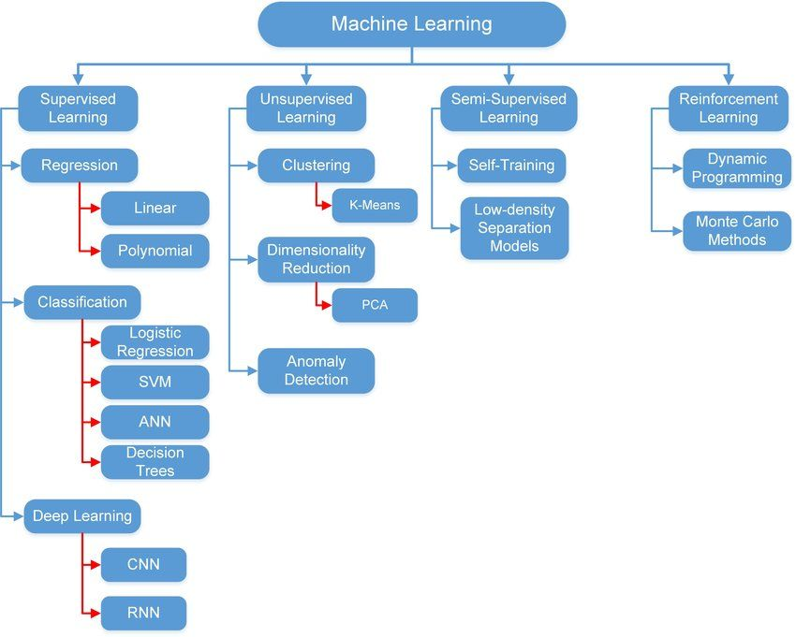
Literature
The focus of the literature study was to explore the different types of machine learning (supervised, unsupervised, semi-supervised and reinforcement learning) and some of the many algorithms that which fall under these types.
A quick explanation of what is machine learning and how is it being used was provided. Following that information, the many forms of machine learning were discussed, along with details about each. Some of the various supervised and unsupervised learning algorithms were then examined.
To conclude the literature review, relevant work that was similar to the study being undertaken was discovered and investigated; this work would then be compared to the research conducted in the results and findings section.

Slide 6
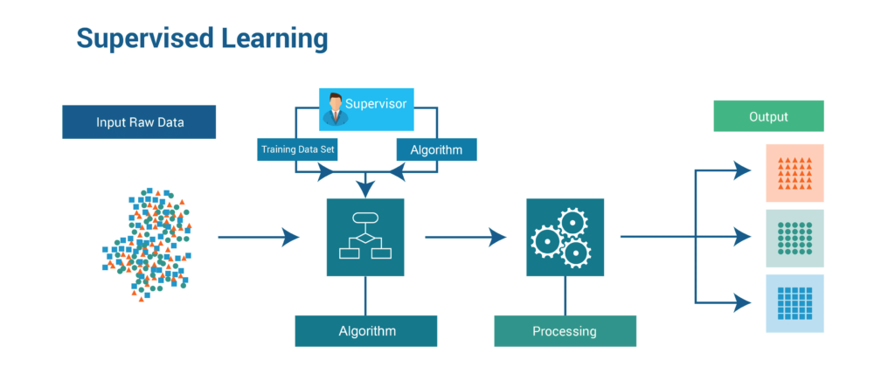
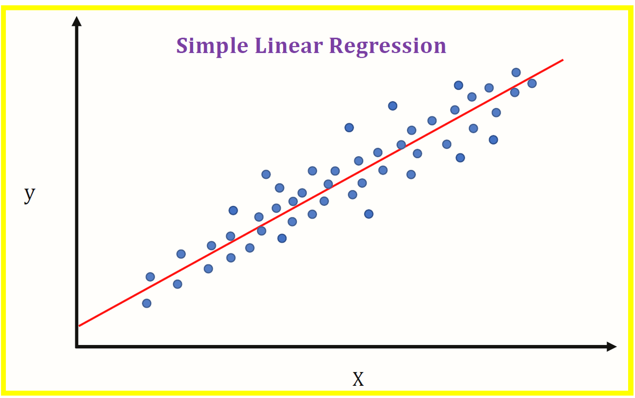
Literature – Supervised Learning Algorithms
The design of algorithms capable of producing broad patterns and hypotheses by utilizing externally given cases to forecast the destiny of future instances is known as supervised machine learning. The goal of supervised machine learning classification algorithms is to categorize data based on past knowledge. In data science challenges, classification is used rather frequently. (A. Singh, N. Thakur, and A. Sharma, 2016).
Some supervised learning algorithms were discussed in this chapter, these included regression and support vector machines (SVM).
In the regression subsections simple linear, multiple linear and polynomial regression were explored. This included comparing these algorithms and discussing in which type of experiment they are mainly used.
The Support vector machine (SVM) algorithm was also discussed as a subsection of supervised learning algorithms, Discussing how SVM is a better term for an ideal “hyperplane” that separates observations into different classes based on patterns of information about those observations called features.

Slide 7
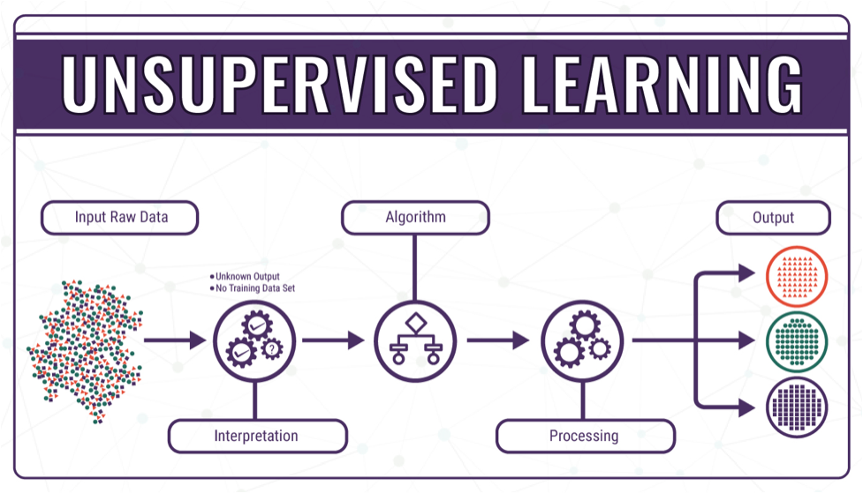
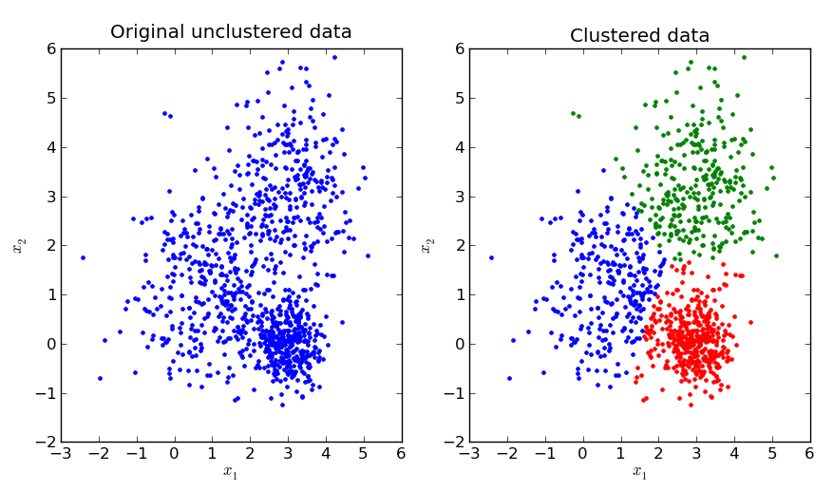
Literature – Unsupervised Learning Algorithms
Unsupervised machine learning approaches make it easier to analyze raw information, allowing for the generation of analytic insights from unlabeled data (Usama et al., 2019). Unsupervised approaches don't require a training set with prior knowledge of object class labels as input. Unsupervised algorithms can find potentially interesting and new cluster formations in a dataset. When class label data isn't available, they can also be utilized. (Lopez, Salameh, and Tucker, 2018)
In this section, two distinct unsupervised algorithms were discussed: agglomerative hierarchical clustering and K-means clustering. Each one was thoroughly discussed, describing how the unlabelled data is used and divided into the different clusters from the original unclustered set of data.

Slide 8



Methodology – Software
The environment had to be set up before the algorithms could be implemented. This necessitated the installation of some software, packages, and extensions.
Visual Studio Code – Visual Studio code also commonly referred to as VS code, is a source-code editor that features include debugging, syntax highlighting, IntelliSence, and Extensions. This software was preferred over other options such as Jupyter.org.
Python 3 – A high-level, interpreted, general purpose programming language. Its design philosophy emphasizes code readability with the use of significant indentation. This programming language paired well with visual studio code and the Jupyter notebook framework.
Anaconda Prompt – Anaconda is a package and environment manager mainly used for python programs, this can be utilized for other languages such as R. This was used to create an environment for the experiment, installing packages such as pandas, matplotlib, numpy, etc.

Slide 9
Methodology – Implementation
After the environment was setup with the appropriate applications, extensions, and libraries installed, the implementation stage was commenced. In this stage, a number of steps were taken to achieve the ultimate goal of answering the hypothesis and research question. These steps include:
Selecting the environment created
Importing the Dataset
Exploring the Data
Cleaning of the data
Visualisation of results obtained from the regression model
Creation of the model of regression analysis
Train/Test Split
Visualisation of the data
Metrics generated for each of the target variables
Creation of the hierarchical clustering model
Visualisation of results obtain from the clustering model
Visually compare the results obtained of each model

Slide 10
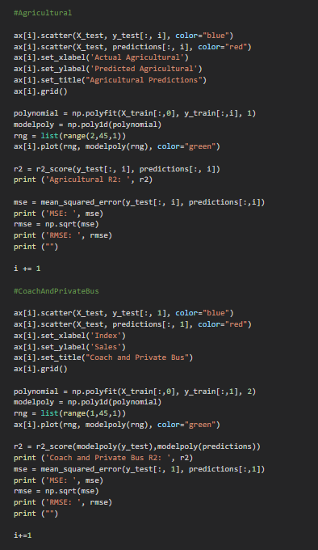
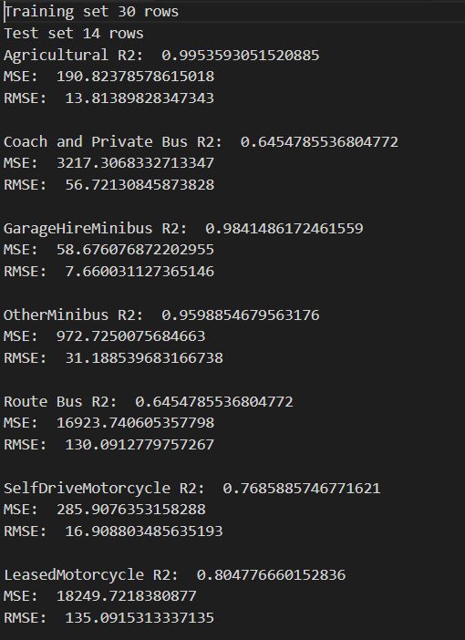
Methodology – Regression Code & Metrics
Simple Linear Regression
Polynomial Regression
Metrics Generated

Slide 11
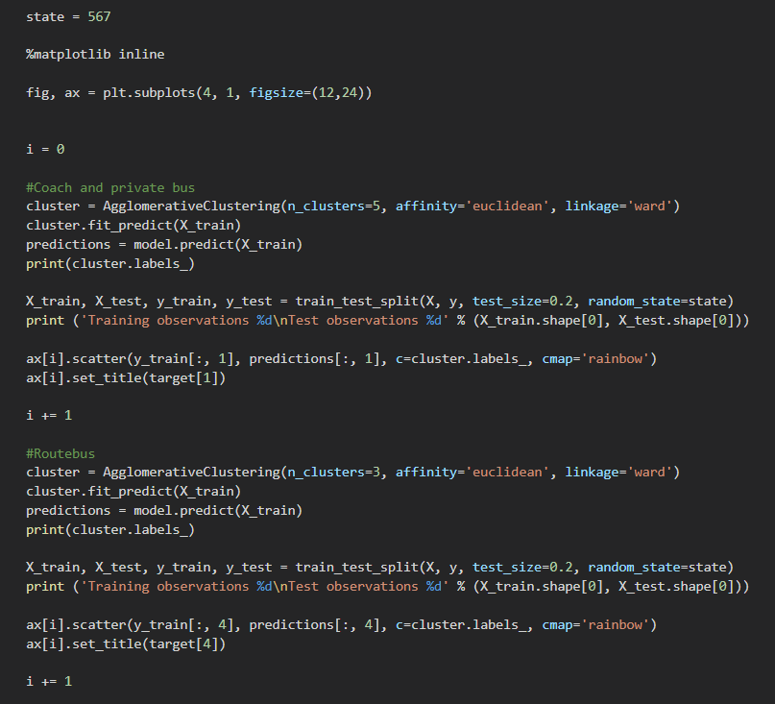
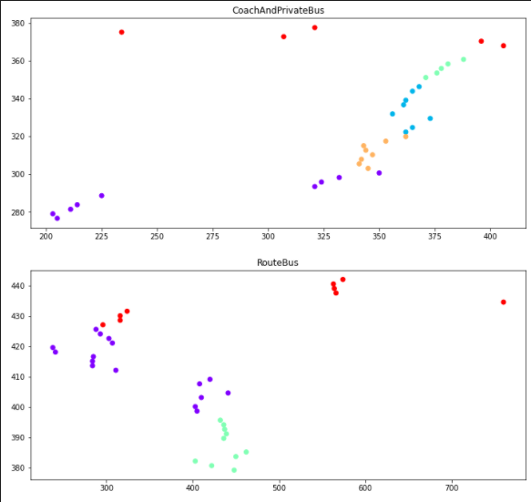
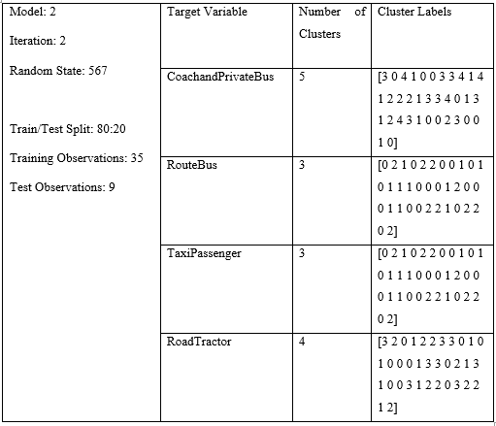
Methodology – Agglomerative Clustering Code and Results
Agglomerative Clustering Code
Scatter plot of the Agglomerative clustering
Agglomerative Clustering Cluster Labels

Slide 12
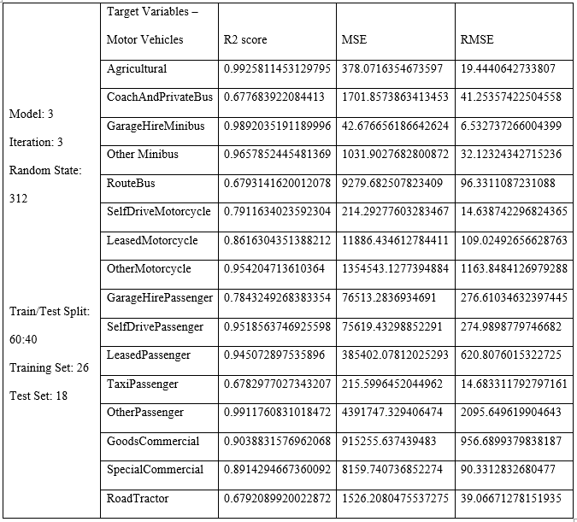
Prototype demonstration
On the right hand side of the screen, the metrics shown were from the third iteration of the third model (60:40 train/test split).
This specific iteration achieved the some of the highest r² score and lowest MSE and RMSE when compared to other model and iterations.

Slide 13
Results
In this section, the metrics obtained from the simple and polynomial regression in the experiment conducted are explained in detail discussing what each of the metrics represent. These metrics mentioned include the r² score, mean squared error (MSE) and the root mean squared error (RMSE).
r² score – The r² score explains the percentage response variation in the target variable. This meant if an r² score of 0.89645 was achieved in the RouteBus target variable, the model would represent 89.645% of the variation in the RouteBus target variables
Mean Squared Error (MSE) – The MSE measures that amount of error in statistical models. It assess the average squared difference between the observed and predicted values. When a model has no error, the MSE equals zero. As the model error increases, its value increases. The mean squared error is also known as the mean squared deviation (MSD)
Root Mean Squared Error (RMSE) – The RMSE is the standard deviation of the residuals (prediction errors). Residuals are a measure of how far from the regression line data points are; RMSE is a measure of how spread out the residuals are. In other words, it tells you how concentrated the data is around the line of best fit.

Slide 14
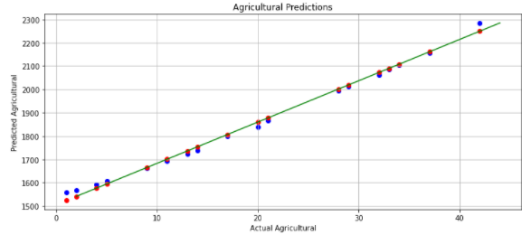
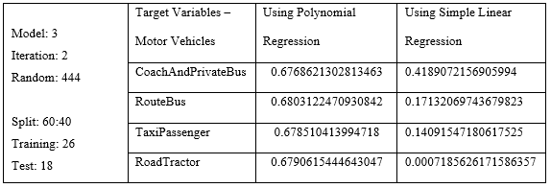
Results – Test Cases
In this experiment, three models were generated with three iterations each, each model contained different configurations mainly the train/test split was different for each model and a different random state for each iteration. In this section, the results obtained in each iteration of each model were observed and discussed.
r² scores obtained showing the improvement from one algorithm to another.
Scatter Plot of the Agricultural target variable with an r² score of 99.42996025536305%

Slide 15
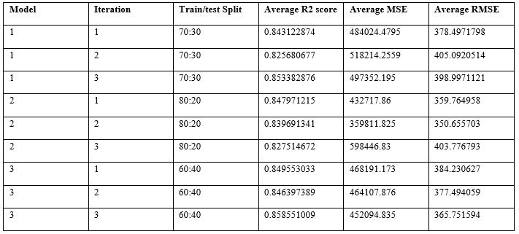
Results – The average results of each model

Slide 16
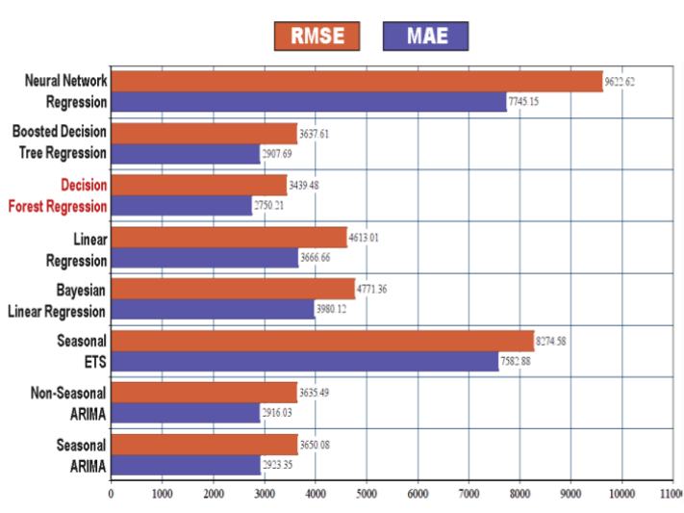
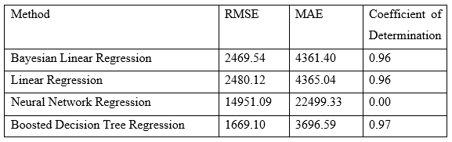
Results – Comparing Results
An important part of this study was to compare the results obtained with those of another researcher. The research found was conducted by (CATAL et al., 2019) on benchmarking of regression algorithms and time series analysis techniques for sales forecasting rather than on motor vehicles, this study was based on the fashion industry. A number of algorithms were tested using the Walmart sales data.
The study was limited to one department within the Walmart store, The r² score (referred to as Coefficient of Determination) of the Bayesian, Linear and Boosted Decision Tree regression was over 95%. These results were of one department within the Walmart. When comparing the results of linear regression to the experiment conducted, the average r² score of motor vehicles would be approximately 84%. To better compare results, individual target variable scores needed to be set from both experiment such as different types of clothing and the different types of motor vehicles

Slide 17
Conclusions
To discover the best appropriate method for each target variable, three algorithms were examined for each target variable. The bulk of the findings from the algorithms examined reveal that simple linear regression is the most suitable.
The best results were obtained from the third iteration of the third model, the best average r² score was obtained by this iteration. This Iteration obtained an average r² score of 0.858551009 (85.855%), the lowest r² scores were obtained of the second iteration of the first model and the third iteration of the second model.
Another important aspect when considering the best model was the mean squared error (MSE) and the root mean squared error (RMSE). These metrics are better when the results obtained are low, having low values means that the residual error (the distance between the point and the line of best fit).

Slide 18
Limitations & Future Recommendations
Limitations of the Study
Time period – The second limitation was based on the news releases, the data provided was divided into quarters, this meant that each numerical value listed in the dataset was based on three months worth of vehicle sales, given that this time period was provided, a number of factors could have affected a single numerical value. These can include change in laws, benefits on a specific form of transportation as well as a change in registration of a specific vehicle. This meant that a deeper element of research is needed to find the cause and effect of the abnormalities.
Future Recommendations
Technology Readiness Level (TRL) – The experiment was tested up to readiness level 3, this meant that the experiment finished the research stage, the next step would be to test this in a real-world environment. This means that going into the development stage of the Technology Readiness Level (TRL), so that eventually the experiment would reach the deployment stage.
Abnormalities/Spikes in the data – Throughout the data exploration as well as the data visualization, abnormalities/spikes in the data were discovered. The results of this phenomenon was not discovered through this research, this can be investigated by communicating with the original source supply the information (Transport Malta) to identify the changes that might have been done.

Slide 19
References
Singh, A., Thakur, N. and Sharma, A. (2016). A review of supervised machine learning algorithms. pp.1310–1315.
CATAL, C., ECE, K., Arslan, B. and Akbulut, A., 2019. Benchmarking of Regression Algorithms and Time Series Analysis Techniques for Sales Forecasting. Balkan Journal of Electrical and Computer Engineering, pp.20-26.
Usama, M., Qadir, J., Raza, A., Arif, H., Yau, K.A., Elkhatib, Y., Hussain, A. and Al-Fuqaha, A. (2019). Unsupervised machine learning for networking: Techniques, applications and research challenges. IEEE Access, 7, pp.65579–65615. doi:10.1109/ACCESS.2019.2916648.
Lopez, C., Tucker, S., Salameh, T. and Tucker, C. (2018). An unsupervised machine learning method for discovering patient clusters based on genetic signatures. Journal of Biomedical Informatics, 85, pp.30–39.

Slide 20
Thank you Mark Anthony Micallef

